Slide 1
From Collections & Services to Features & Algorithms:
New roles for libraries in the age of artificial intelligence
Corey Harper -- @chrpr
IGeLU 2017
11 September 2017
Contributions: Brad Allen, Paul Groth

Slide 2
Artificial
Intelligence
Is Here

Slide 3
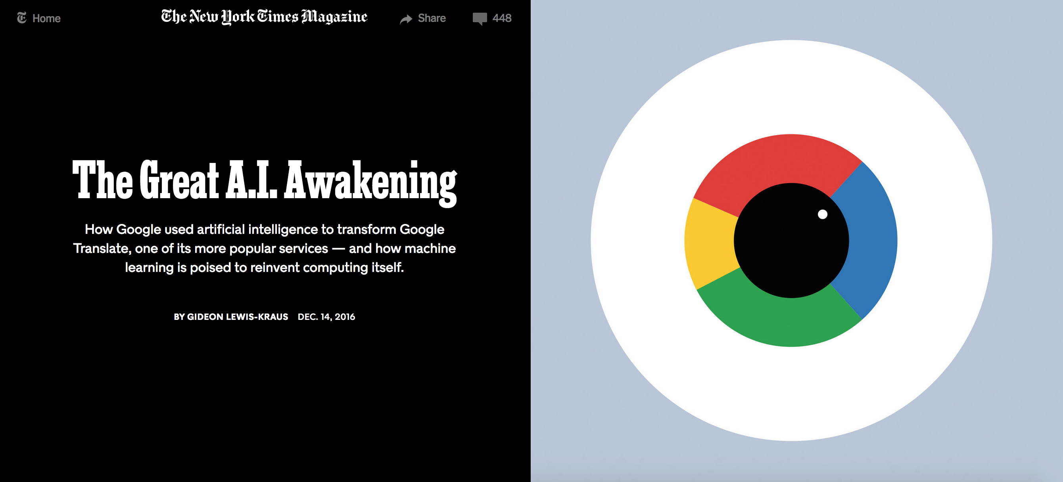
Knowledge organization is important
https://www.nytimes.com/2016/12/14/magazine/the-great-ai-awakening.html

Slide 4
Benchmarks are being Shattered
“…overnight improvements roughly equal to the total gains the old [system] had accrued over its entire lifetime.”
Not just machine translation
Huge improvements seen in
Human Speech Recognition
Computer Vision
Speech and text generation
Question Answering

Slide 5
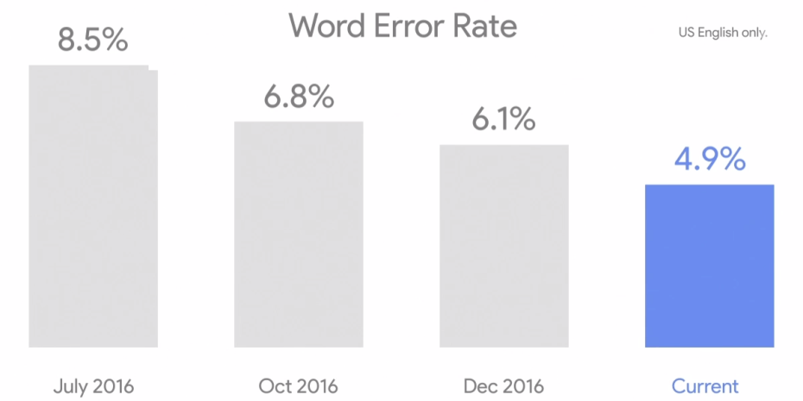
Human Speech Recognition
Was 23% in 2013, and over 35% in 2012.
https://venturebeat.com/2017/05/17/googles-speech-recognition-technology-now-has-a-4-9-word-error-rate/
Notes:
Sundar Pichai

Slide 6
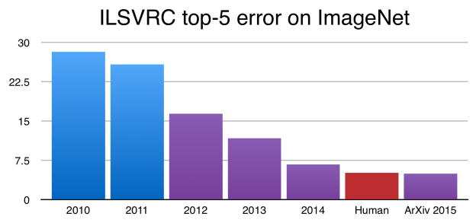
Image Recognition
https://devblogs.nvidia.com/parallelforall/author/czhang/

Slide 7
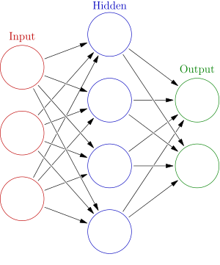
Deep Learning – Neural Networks

Slide 8
AI, Machine Learning, Deep Learning
Deep Learning
Machine Learning
AI

Slide 9
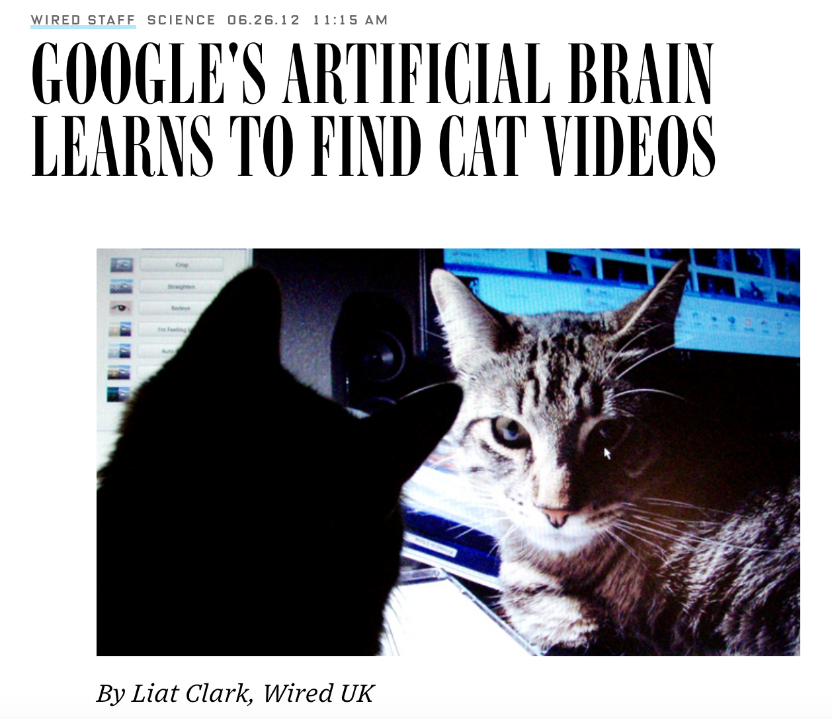
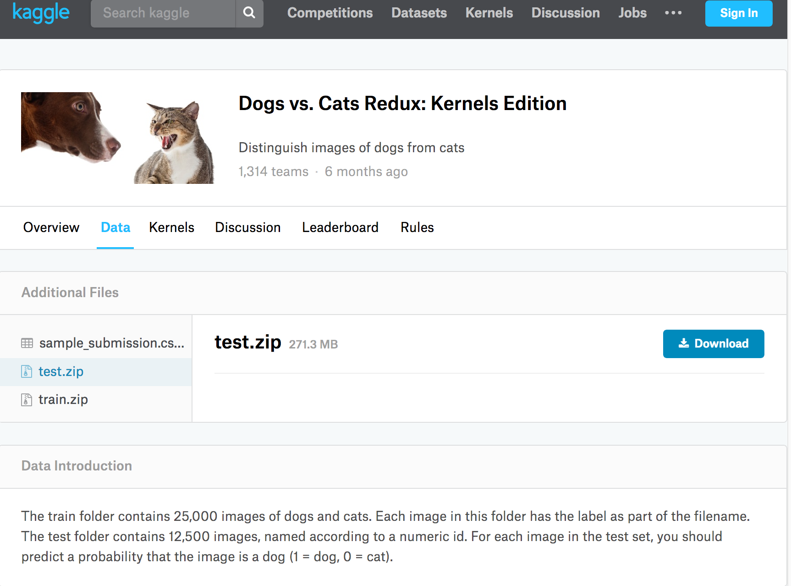
Supervised Learning vs Unsupervised
Supervised Learning vs Unsupervised
https://www.kaggle.com/c/dogs-vs-cats-redux-kernels-edition/data
https://www.wired.com/2012/06/google-x-neural-network/
https://arxiv.org/abs/1112.6209
Notes:
16k computer processors, 10 million youtube thumbnails, 3 days. Cats. (Also, human faces). But cats!

Slide 10
Supervised Learning vs Unsupervised
Labeled Training & Labeled Test Data
Classifiers
Regression
Decision Trees
Support Vector Machines
Many Neural Networks
Implicit Labels
Latent Semantic Analysis
K-Means Clustering
Some Neural Nets (GANs, word2vec)
Distant or Weak Supervision
Supervised Learning vs Unsupervised

Slide 11
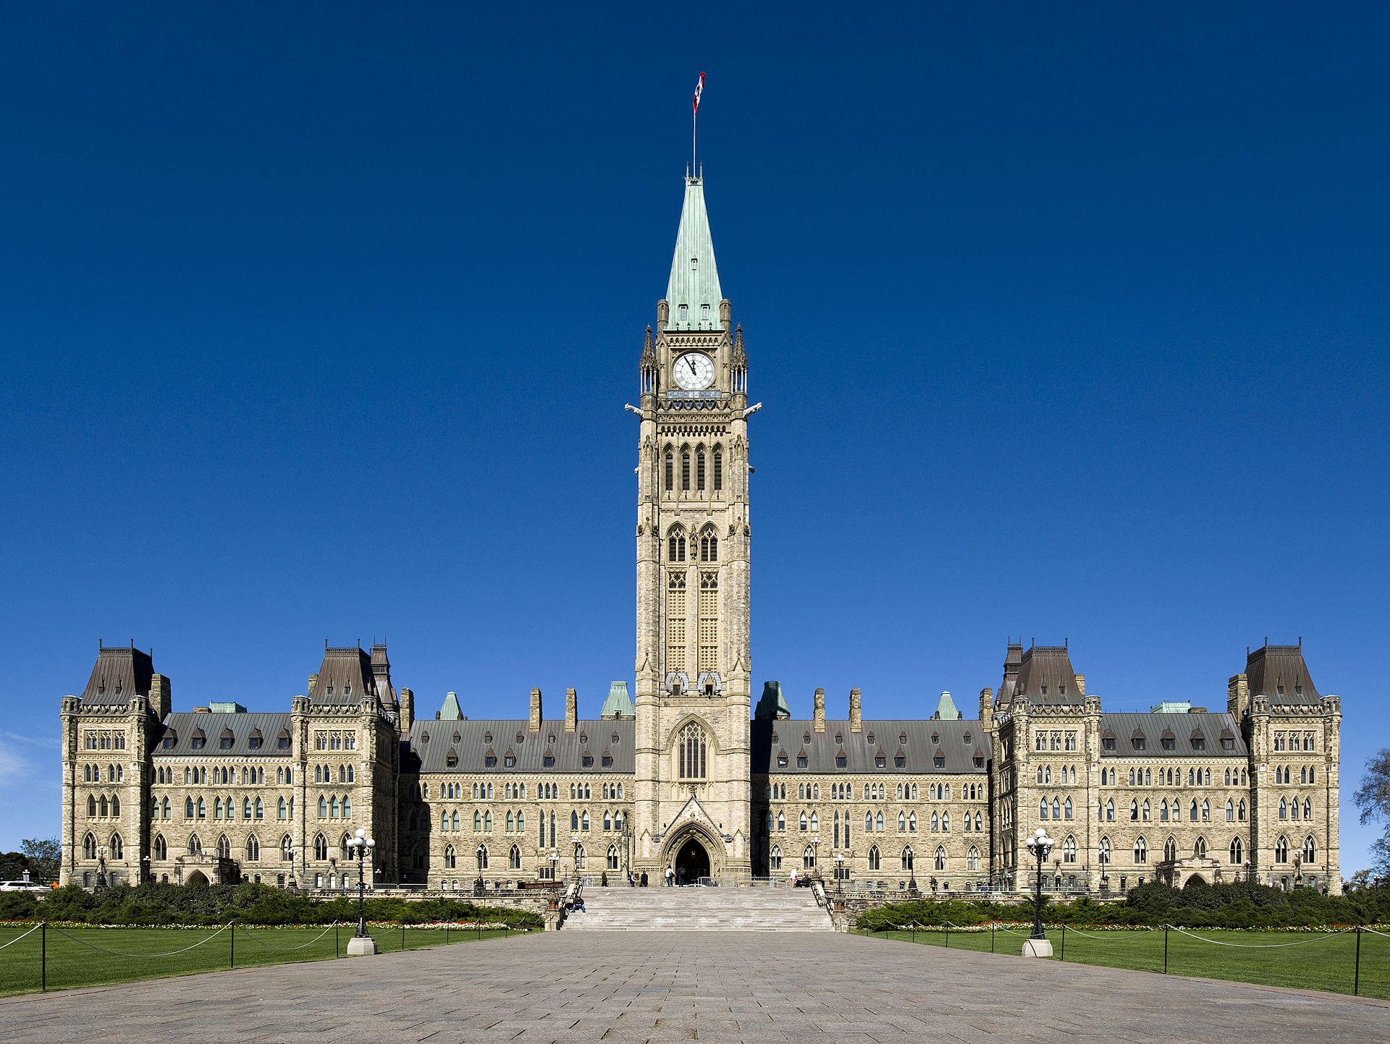
Why is English <-> French the most performant translation task?
By Saffron Blaze - Own work, CC BY-SA 3.0, https://commons.wikimedia.org/w/index.php?curid=28678264

Slide 12
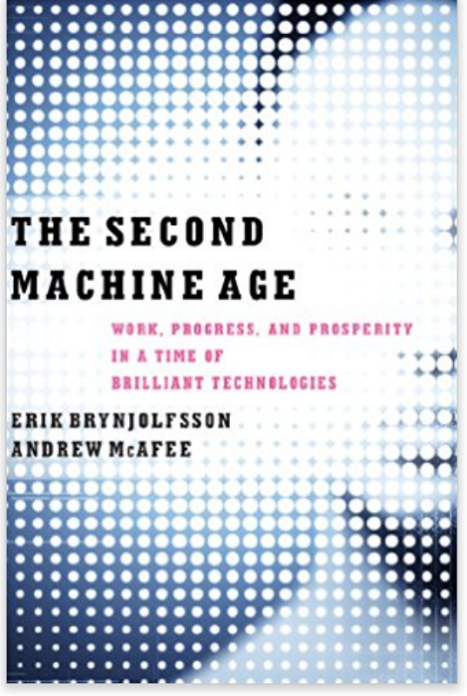
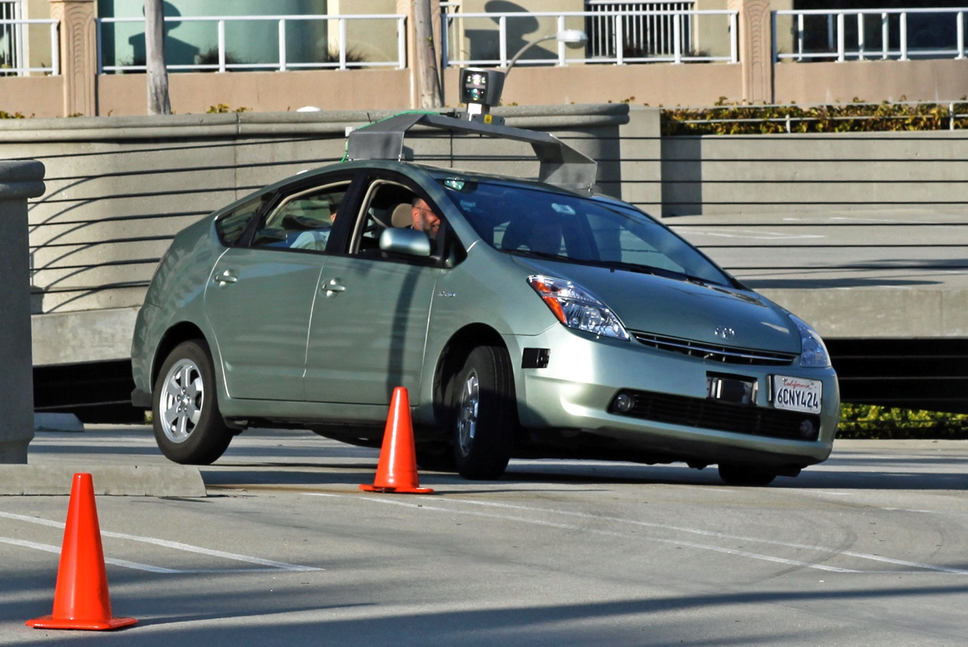
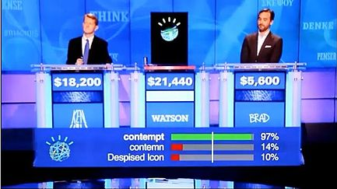
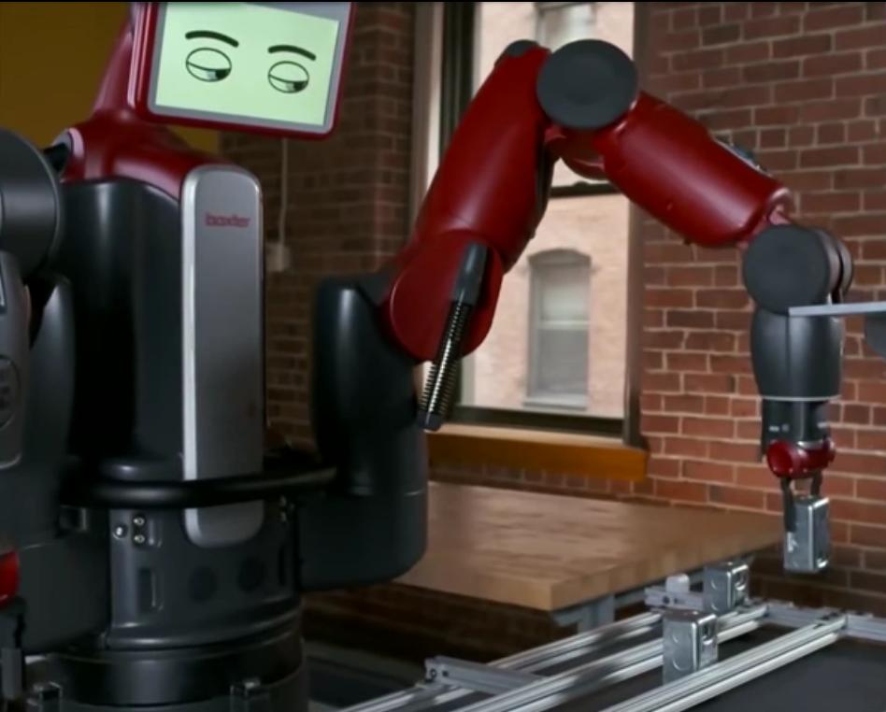
The Second Machine Age
The Second Machine Age
By Flckr user jurvetson (Steve Jurvetson). Trimmed and retouched with PS9 by Mariordo –
http://commons.wikimedia.org/wiki/File:Jurvetson_Google_driverless_car.jpg, CC BY-SA 2.0
By Source, Fair use, https://en.wikipedia.org/w/index.php?curid=31142331
By Salammbo31 - Own work, CC BY-SA 4.0,
https://commons.wikimedia.org/w/index.php?curid=36902398
https://www.amazon.com/Second-Machine-Age-Prosperity-Technologies-ebook/dp/B00D97HPQI

Slide 13
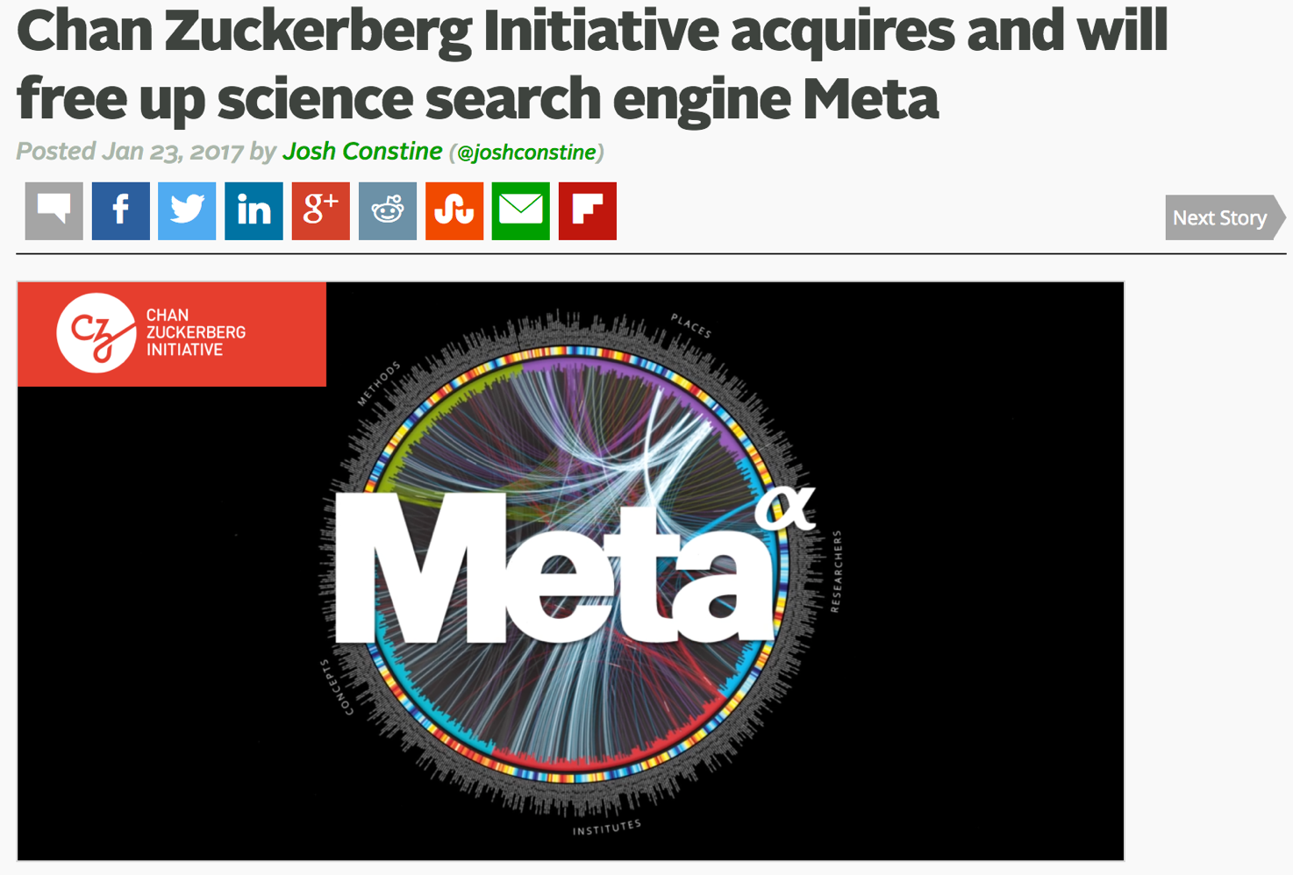

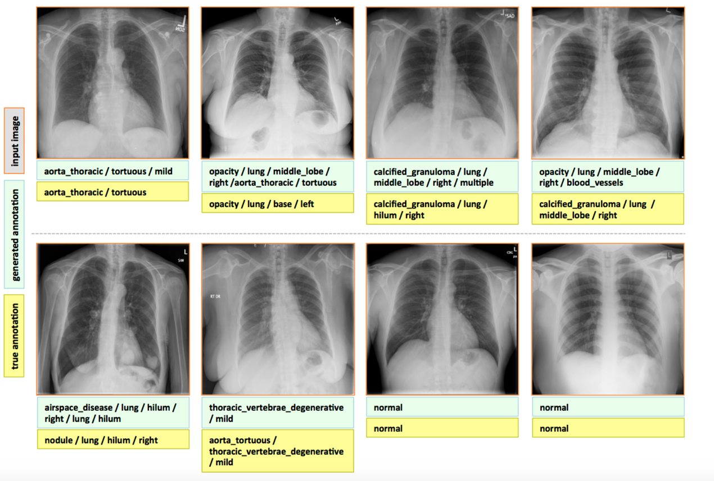


Machine Learning in Health & Medicine
https://techcrunch.com/2017/01/23/chan-zuckerberg-initiative-meta/
https://blogs.nvidia.com/blog/2016/05/10/deep-learning-chest-x-rays/
https://www.crunchbase.com/organization/ibm-watson-health

Slide 14
Applications to Social Good
Precision Medicine, Genomics, Oncology
Agriculture and Nutrition
Smart Cities and Urban Development
Economics and Social Justice
Social Work
Environmental Health and Environmental Justice
Notes:
These examples are pretty commercial. Self-driving cars, industrial automation, and a robot game show contestant.
But the technologies behind this have tremendous potential for social good as well.
But to get there, we need a more even playing field.

Slide 15
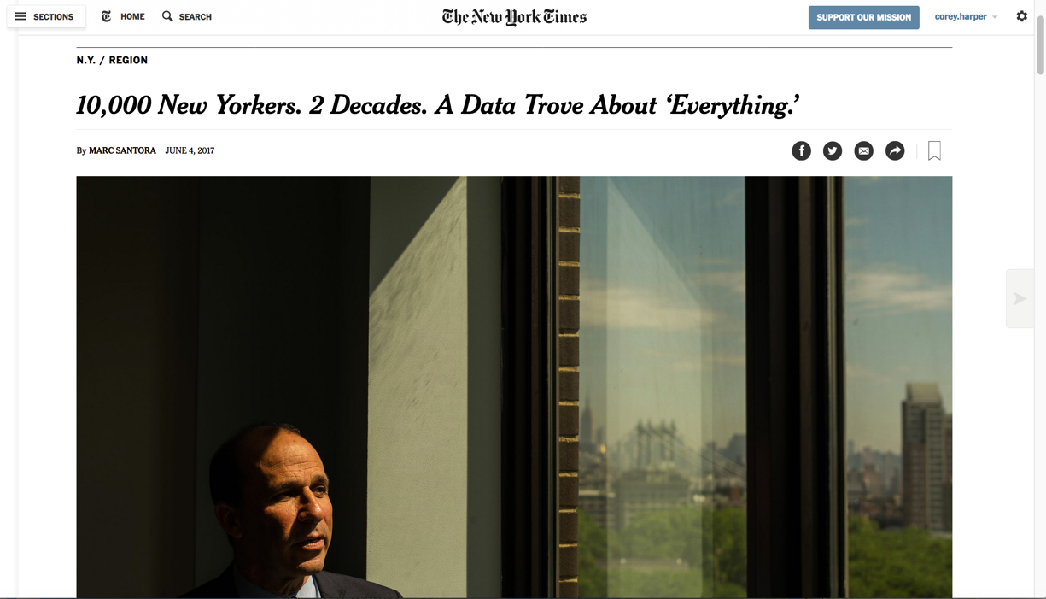

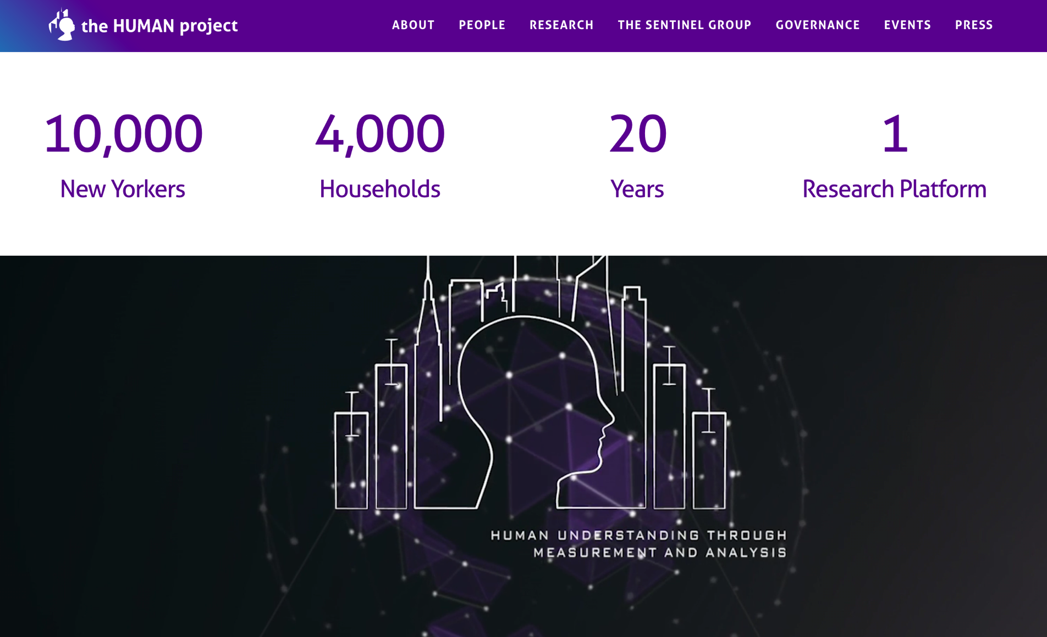
Precision Sciences
http://aims.fao.org/activity/blog/global-data-ecosystem-agriculture-and-food-godan-discussion-paper
https://www.nytimes.com/2017/06/04/nyregion/human-project-new-york-city-study.html
https://www.thehumanproject.org/
Notes:
Elsevier’s work here, Meta, IBM Watson for Health, and many many more.
Internet of things? Now or a bit later?

Slide 16
The need for training data
Machine Learning is pattern recognition
Machine Learning needs millions of examples
There is huge value in training data
Google, Amazon, Baidu, Facebook, IBM…
Common theme? Data
Google “…drew upon both the company’s peerless reserves of data and its massive computing infrastructure.” – NYTimes
Notes:
Notice the companies on that last list!

Slide 17
New Roles
For
Libraries

Slide 18
Roles for Libraries in AI
Applying Machine Learning ourselves
Ranganathan Revisited
Every Algorithm its Dataset
Every Dataset its Algorithm
Save the time of the Machine
Combating the Dark Side of AI
Algorithmic Literacy
Bias Identification
The Role for Libraries in AI

Slide 19
Applications of ML in Libraries
Recommender Systems & Personalization
Machine Assisted Classification
Topic Modeling for Subject Analysis
ML for Format Identification
Knowledge Graph Development
Named Entity Recognition
Open Information Extraction
Relationship Extraction
Universal Schema

Slide 20
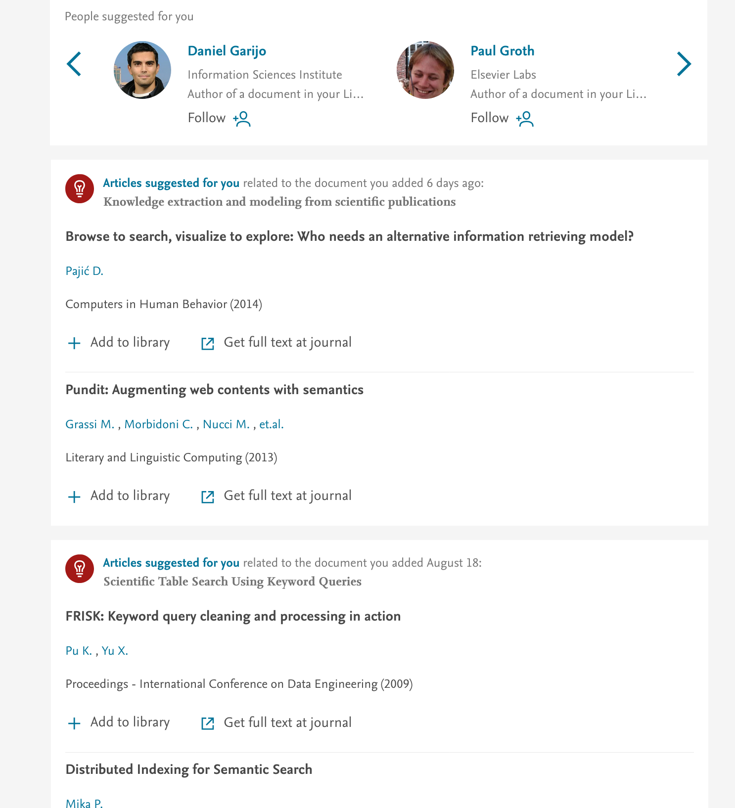
Recommender Systems

Slide 21
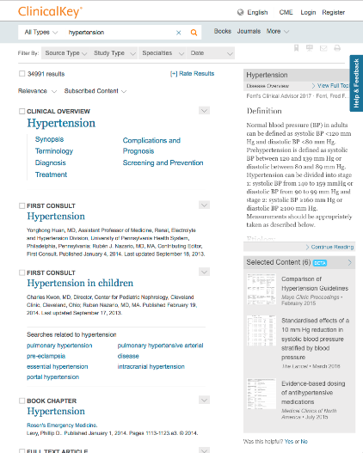
Image Classification based Recommendations

Slide 22
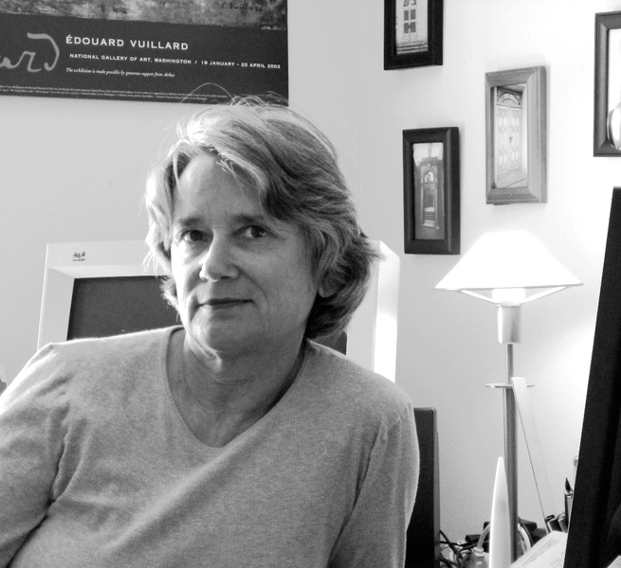
Answers are about things, not just Works
Why shouldn’t a search on an author return information about the author, including the author’s works? Where was the author born, when did she live, what is she known for? … All of this is possible, but only if we can make some fundamental changes in our approach to bibliographic description. ... The challenge for us lies in transforming what we can of our data into interrelated “things” without overindulging that metaphor.
Coyle, K. (2016). FRBR, before and after: a look at our bibliographical models. Chicago: ALA Editions.

Slide 23
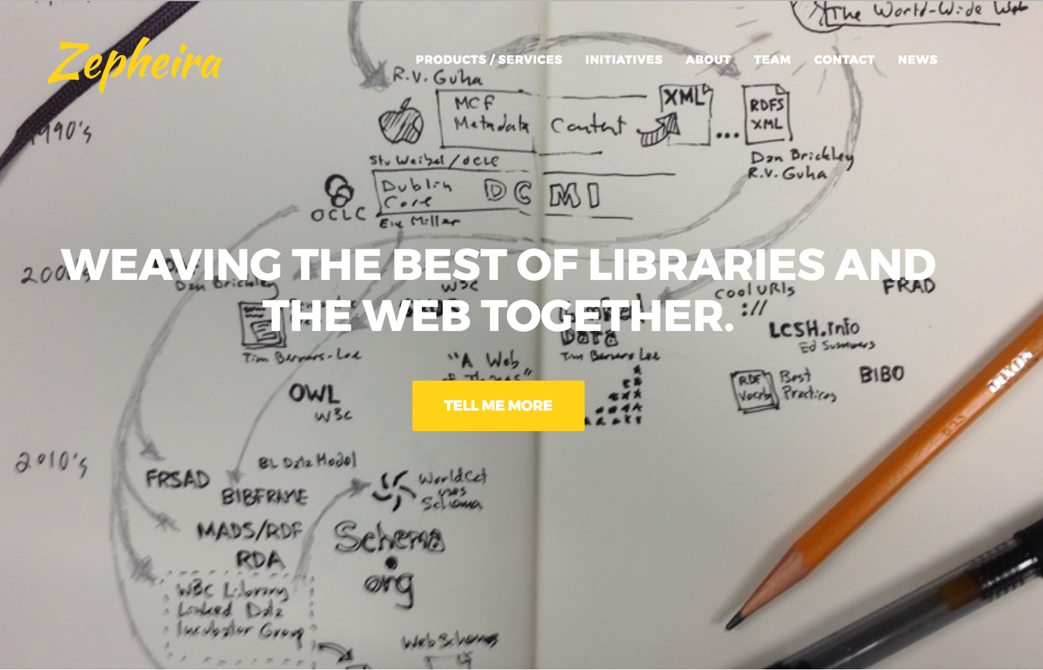

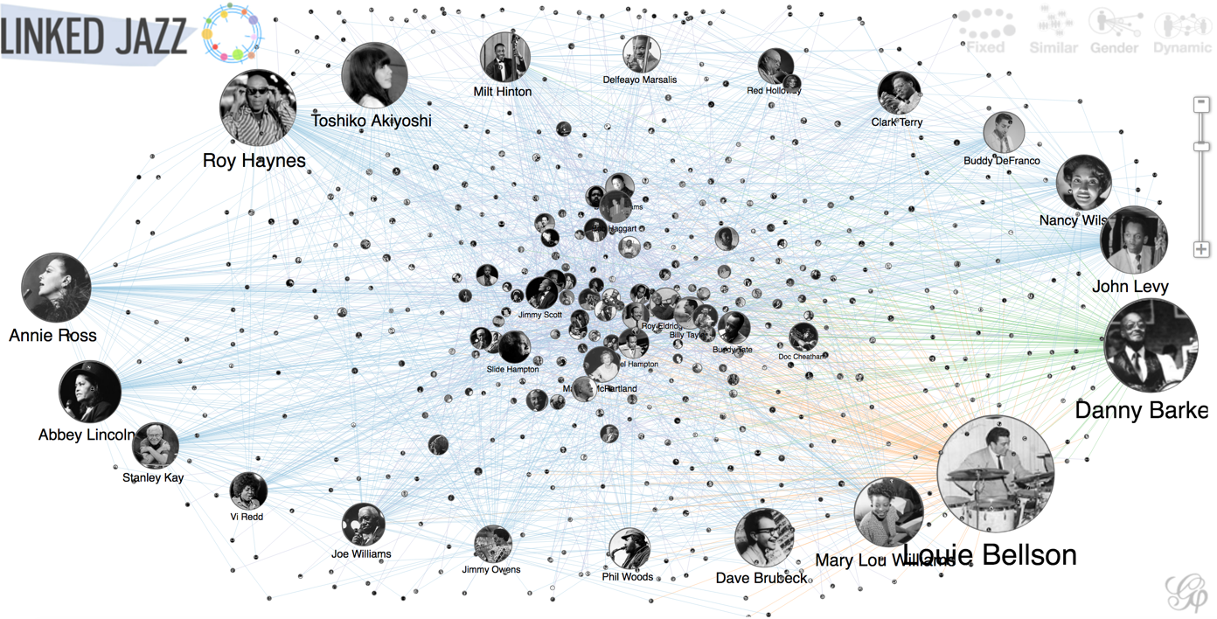
Knowledge Graphs for Research
Plus LAWDI, LOD-LAM, LD4L-Labs, & Many More
https://zepheira.com/ – https://linkedjazz.org/network/ – http://vivo.cornell.edu/

Slide 24
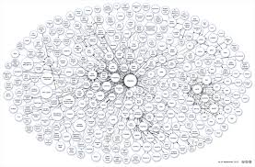
Elsevier’s Knowledge platform
Products
Scopus
SD
ROS
Reaxys
CK
Sherpath
Platforms & Shared Services
Content
Research
Life Sciences
Search
Identity
Knowledge
Graphs
Research
Life Sciences
Healthcare
Entity Hubs
Profile Hub
Journal Hub
Funder Hub
Article Hub
Institution Hub
Data & Content Sources
Articles
Usage logs
Authors
Institutions
Pathways
EHRs
Books
Citations
Funders
Chemicals
Drugs
Syllabi

Slide 25
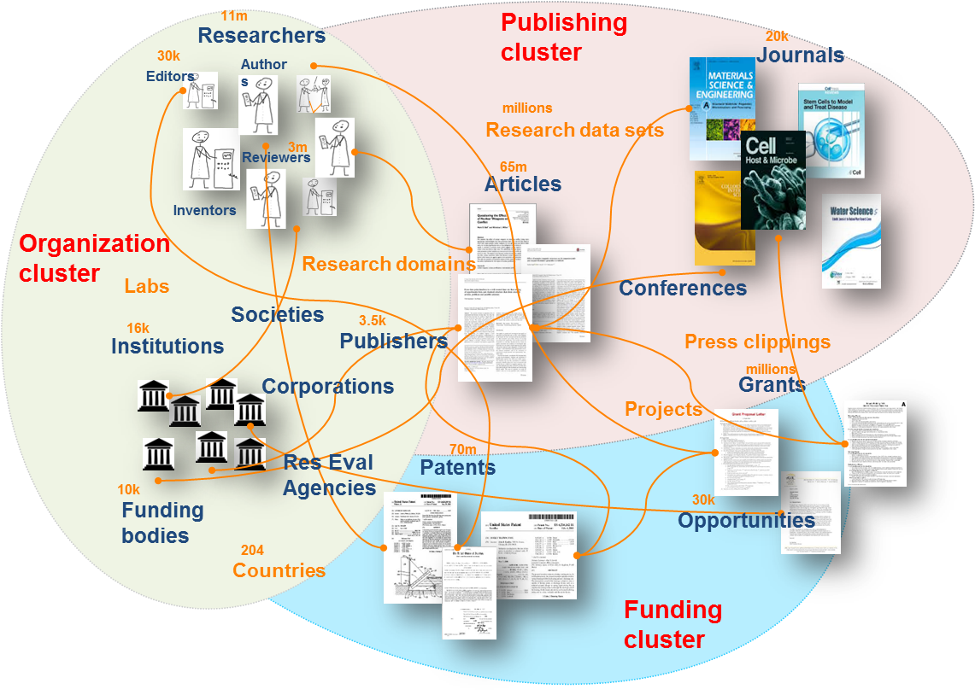
Elsevier: Knowledge Graphs for Research

Slide 26
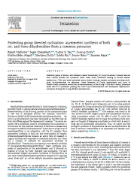
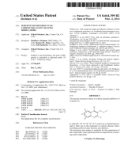
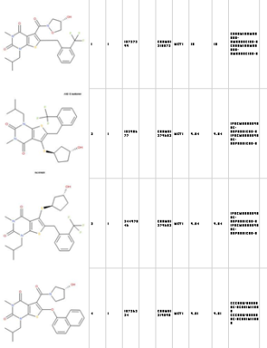
Elsevier: Knowledge Graphs for Life Sciences
Biological Pathways extracted via semantic text mining
Bioactivities
through text analysis
Chemical Structures
And Properties
IC₅₀ 6.3nM, kinase binding assay 10mM concentration
A upregulates B
B upregulates C
C increases disease D
A ⇨ B ⇨ C ⇨ D
EMTREE
NCBI,
Uniprot
InChi,
Name
ReaxysTree,
Structures
Normalizing vocabularies required: proteins, diseases, drugs, chemicals

Slide 27
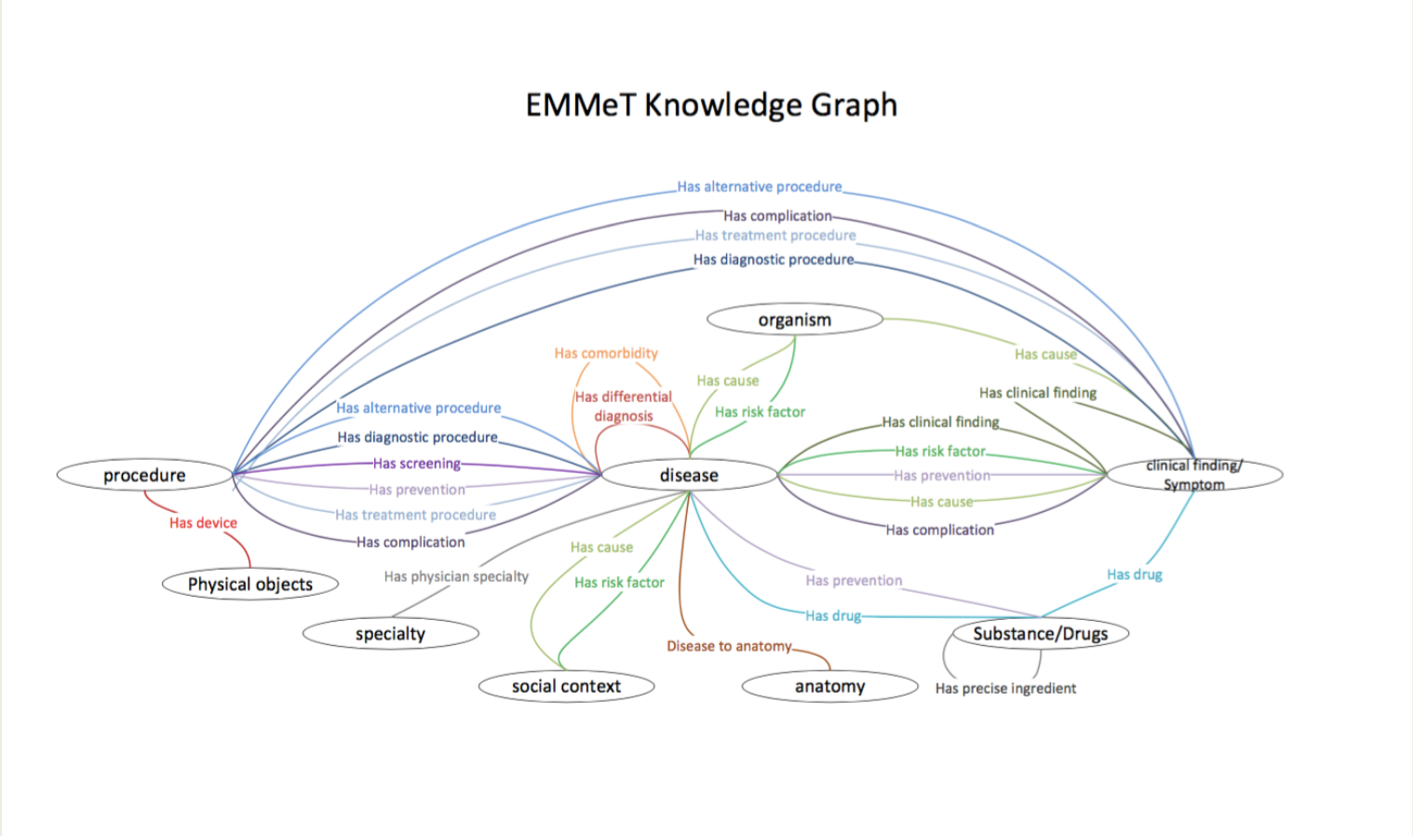
Elsevier: Knowledge Graphs for Healthcare

Slide 28
A Ranganathan Redux
Or…
Ranganathan for Robots
Save the time
of the
Machine
By Jessamyn West cc-by-nc-sa/2.0/
https://www.flickr.com/photos/iamthebestartist/66817517/in/photostream/

Slide 29
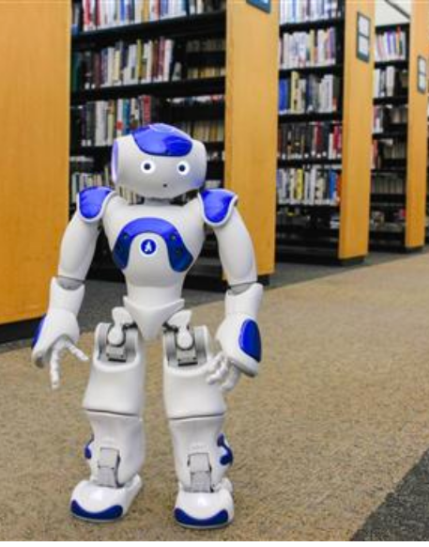
What does it look like to have machines as library patrons?
Curate Training Data
Catalog Data
Help Create Labels
Facilitate Discovery
Curate Models
Access to Tools
Image Source: http://westportlibrary.org/about/news/robots-arrive-westport-library
Notes:
Obviously, this is facetious. The “patron” is the machine learning faculty, not the machine itslelf.

Slide 30
Public Training Data
Health Data
Cancer Genome Data: https://dcc.icgc.org/
Clinical Trial Data: https://clinicaltrials.gov/
De-identified Electronic Medical Records https://mimic.physionet.org/about/mimic/
Web Content
Common Crawl http://commoncrawl.org/
Language Data
Translation Data: http://opus.lingfil.uu.se/
Linguistics Data: http://www.anc.org/data/oanc/
Inference Data: https://nlp.stanford.edu/projects/snli/

Slide 31
Word Vectors
Pre-trained word vectors from Word2Vec: https://code.google.com/archive/p/word2vec/
Pre-trained word vectors from GLoVE: https://nlp.stanford.edu/projects/glove/
Pre-trained FastText word vectors in 294 language from Facebook AI Research: https://github.com/facebookresearch/fastText/blob/master/pretrained-vectors.md

Slide 32
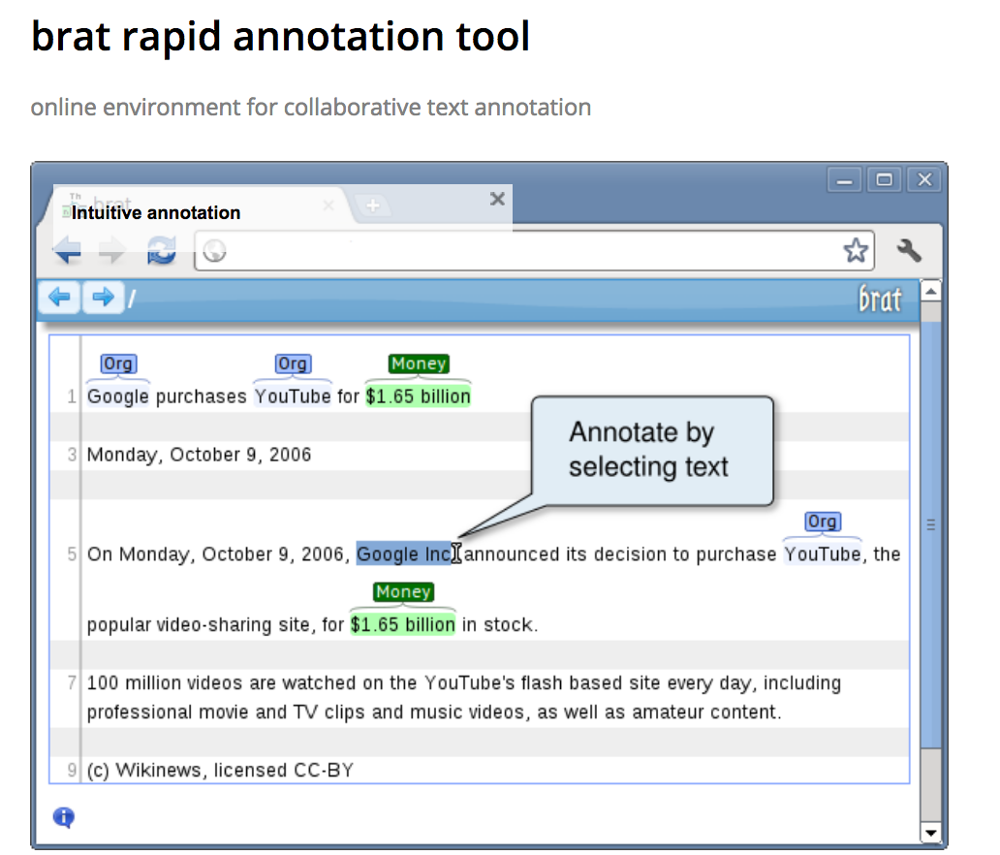
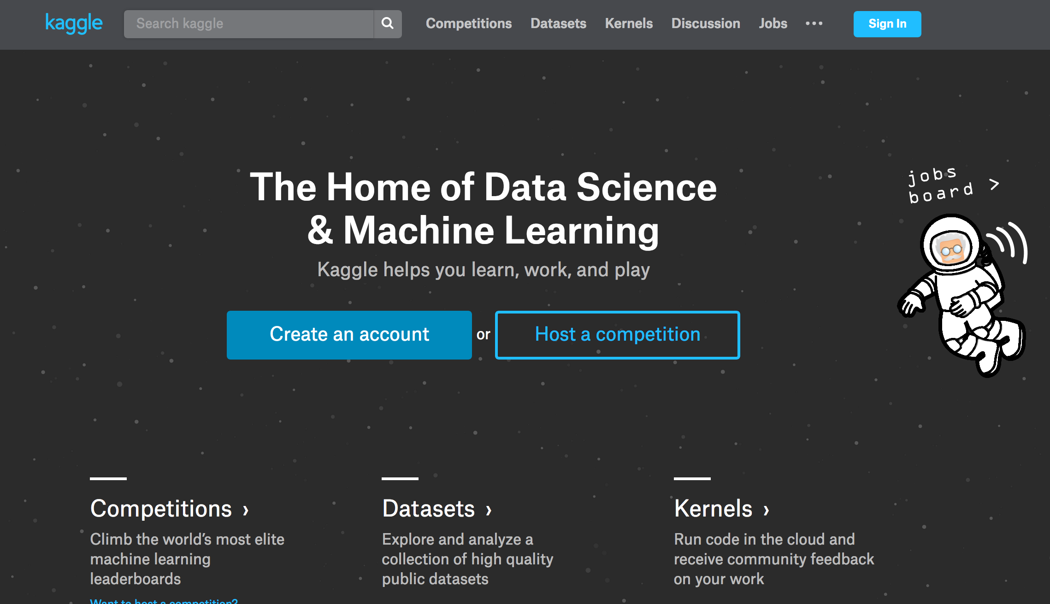
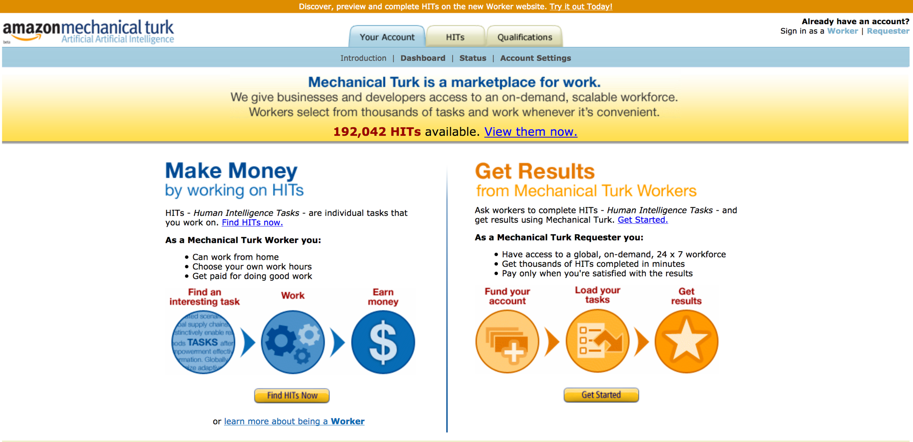
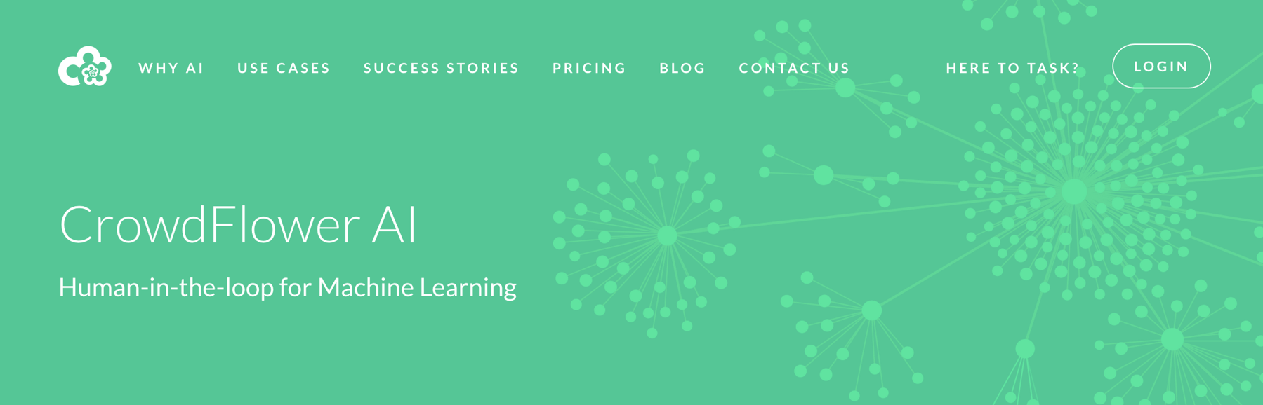
Contests and Crowdsourcing
http://brat.nlplab.org/ – https://www.mturk.com/mturk/welcome – https://kaggle.com/
https://www.crowdflower.com/machine-learning-with-crowdflower/

Slide 33
Are any libraries collecting and providing access to this stuff?
Do libraries have Machine Learning expertise on staff to help faculty and students find appropriate training data?

Slide 34
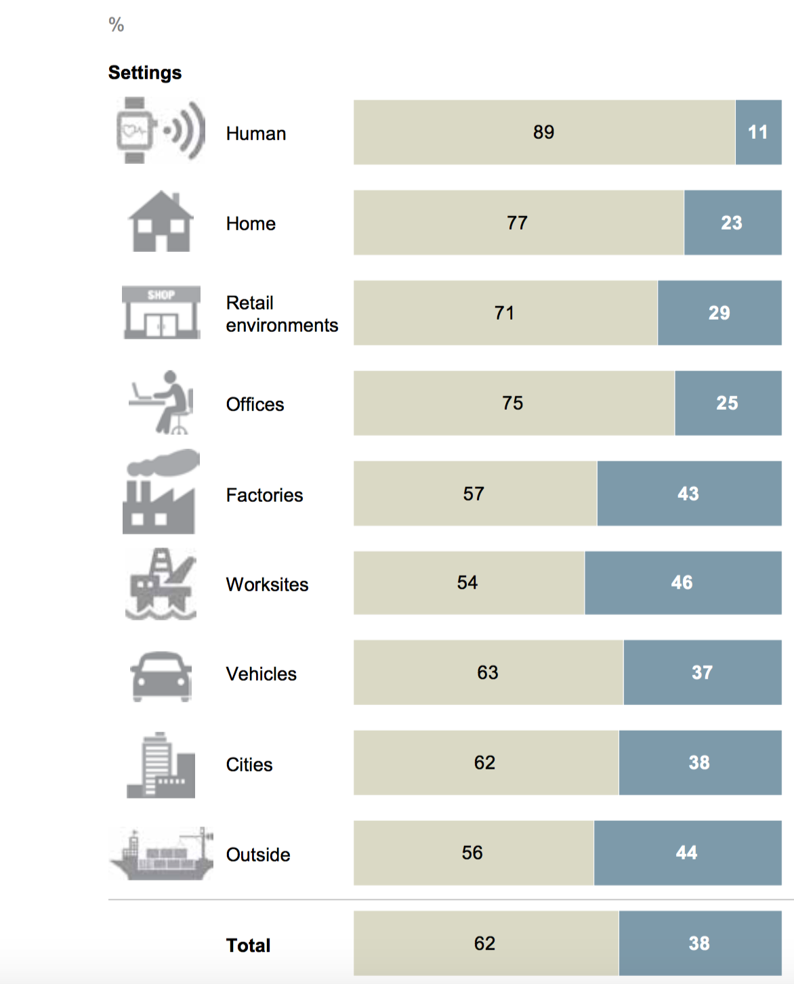

Internet of Things ”Edge” Data
McKinsey: $11.1T / year by 2025
Gartner projects 20B Internet connected devices in 2020
http://www.mckinsey.com/business-functions/digital-mckinsey/our-insights/the-internet-of-things-the-value-of-digitizing-the-physical-world

Slide 35
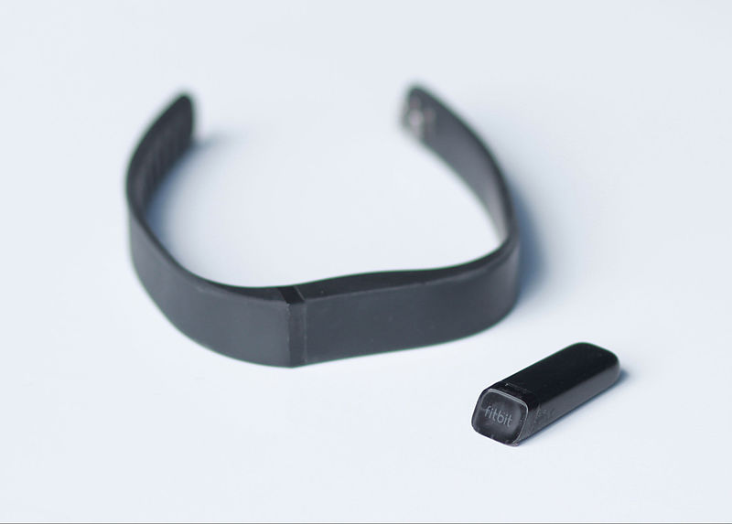
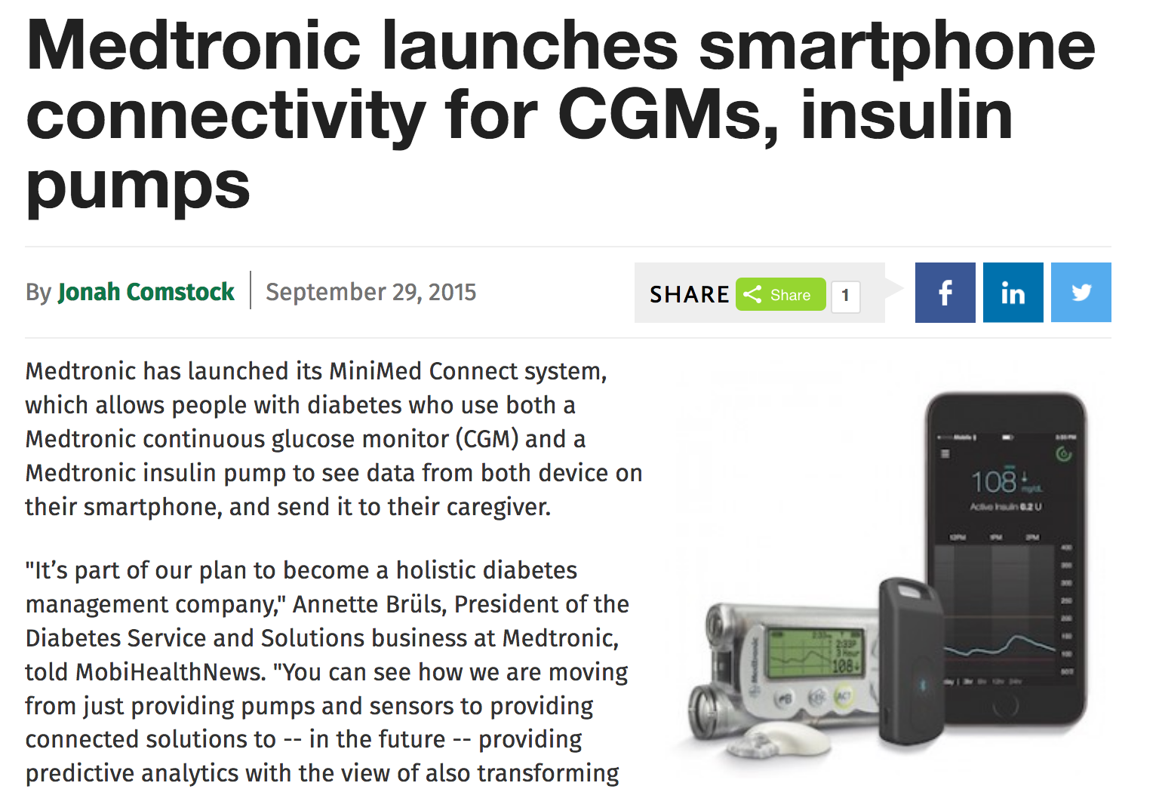
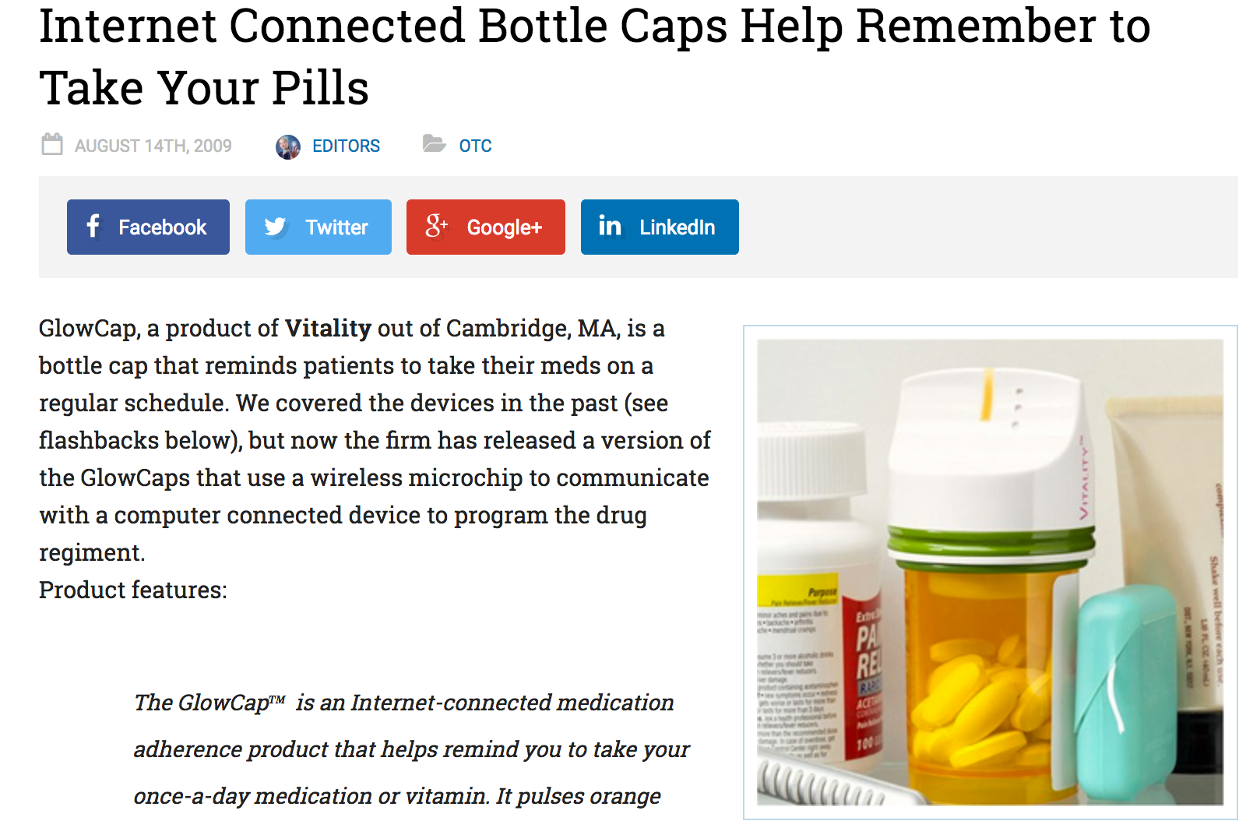
https://en.wikipedia.org/wiki/Fitbit#/media/File:Fitibit_Flex.jpg
https://www.medgadget.com/2009/08/internet_connected_bottle_caps_help_remember_to_take_your_pills.html
http://www.mobihealthnews.com/47112/medtronic-launches-smartphone-connectivity-for-cgms-insulin-pumps

Slide 36
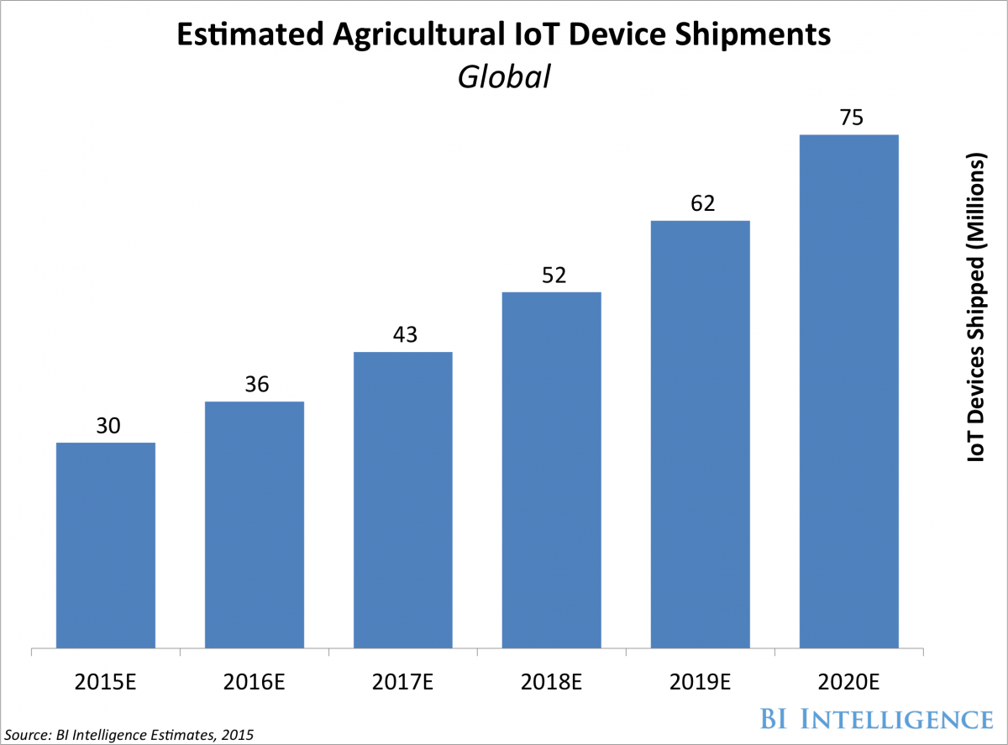
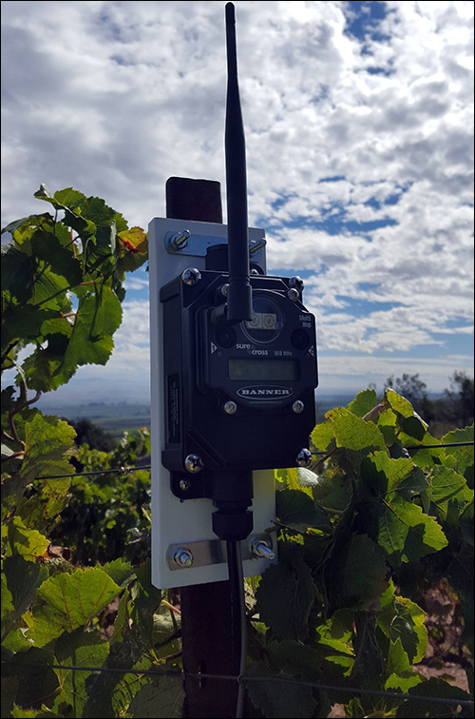

http://www.businessinsider.com/internet-of-things-smart-agriculture-2016-10
http://www.iotjournal.com/articles/view?13777
http://rachio.com/how-it-works

Slide 37
Roles for Information Professionals
Data Aggregation
Collection, curation, and search
Normalization and alignment
Identifier management
Format standardization
Contextualization Services
Enrich with information from literature and knowledge graphs.
Identifying and Documenting Biases

Slide 38
The Dark
Side Of
Artificial Intelligence

Slide 39


Slide 40

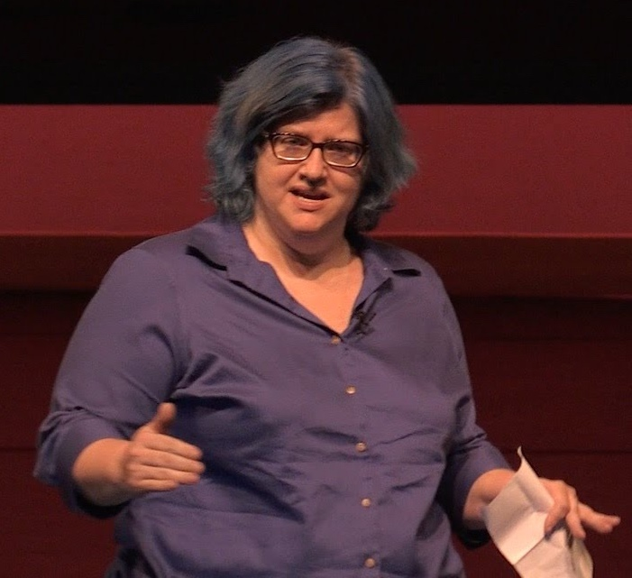
Weapons of Math Destruction
“Ill-conceived mathematical models
now micromanage the economy,
from advertising to prisons.”
https://weaponsofmathdestructionbook.com/
https://www.ted.com/talks/cathy_o_neil_the_era_of_blind_faith_in_big_data_must_end

Slide 41
Algorithms Sorting People
Making decisions about:
Loan eligibility
Teacher effectiveness
Insurance premiums
Job applications
Where to send our cops
Recidivism & parole

Slide 42
Feedback Loops
“Employers, for example, are increasingly using credit scores to evaluate potential hires. Those who pay their bills promptly, the thinking goes, are more likely to show up to work on time and follow the rules...
“But the belief that bad credit correlates with bad job performance leaves those with low scores less likely to find work... worsens their credit scores...
“It's a downward spiral.”

Slide 43
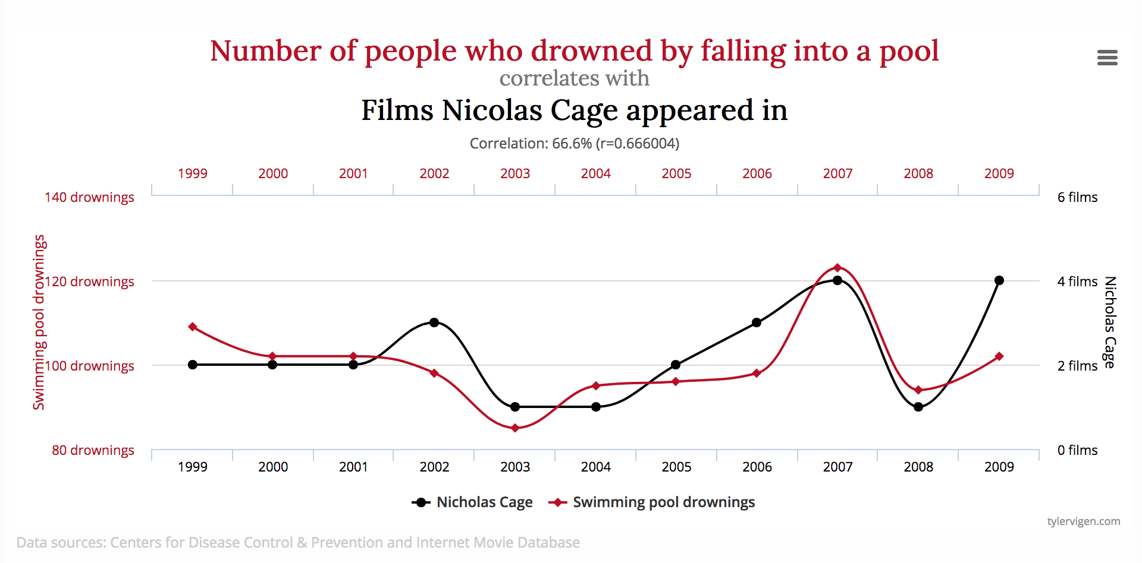
Spurious Correlations ~= Causality
http://www.tylervigen.com/spurious-correlations

Slide 44
Machine Bias
Proxy Data Points
Small Data Samples
Overfitting
Discriminatory Leakage
We wouldn’t use race in a formula
But zip code + age of first encounter with police + brother’s criminal record?

Slide 45
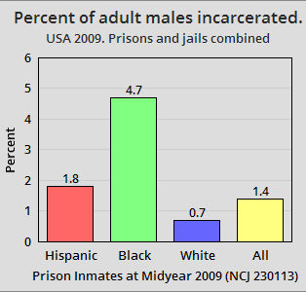
Data Bias
Training data is Labeled Data
If recidivism data is from the legal system?
By Timeshifter. Chart was made at chartgo.com - see chart here. - Own work, CC0,
https://commons.wikimedia.org/w/index.php?curid=37339697

Slide 46
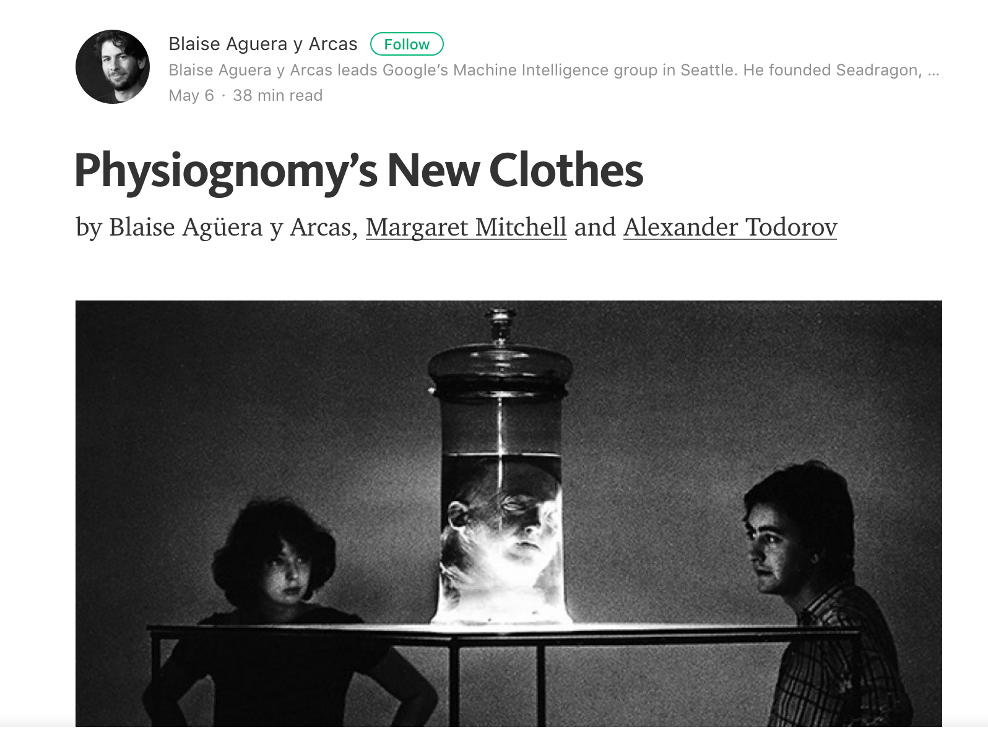
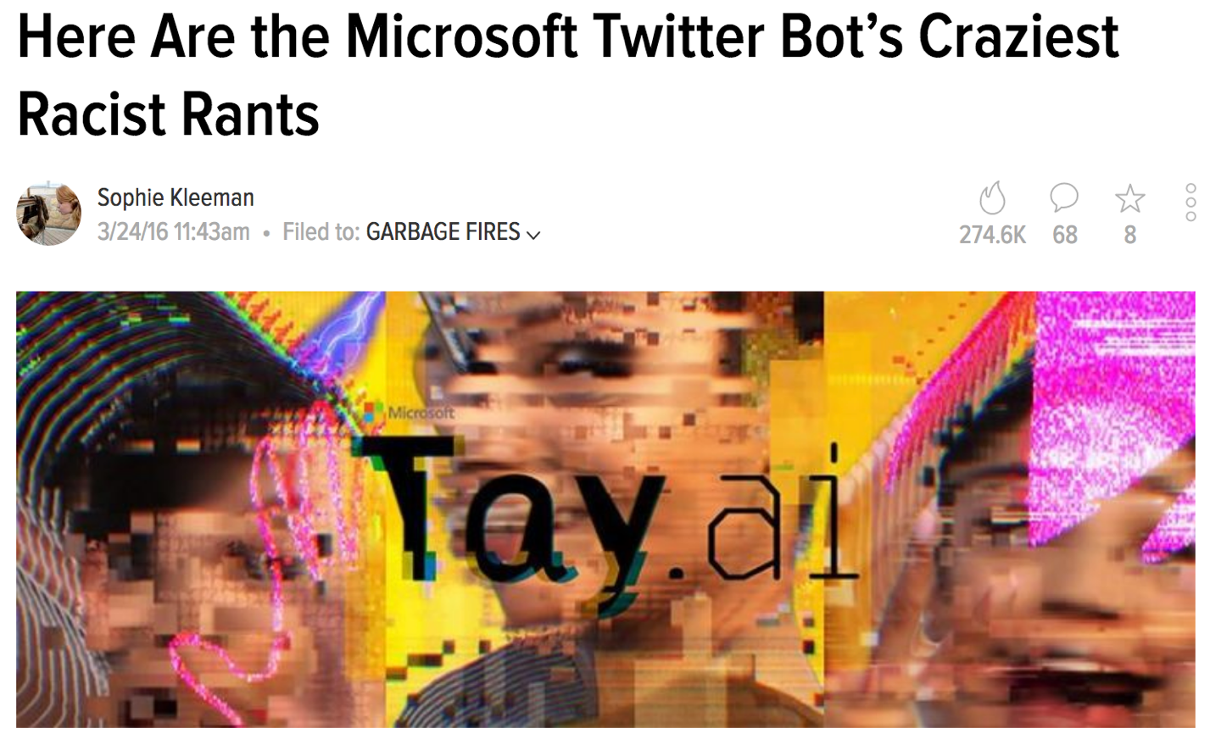
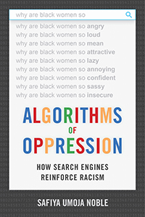


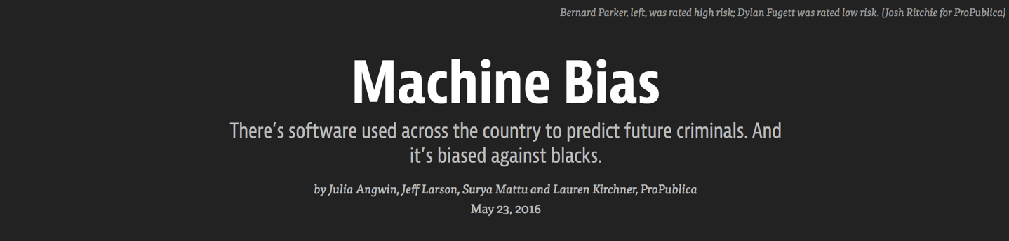
Algorithmic Bias
http://gizmodo.com/here-are-the-microsoft-twitter-bot-s-craziest-racist-ra-1766820160
https://medium.com/@blaisea/physiognomys-new-clothes-f2d4b59fdd6a
https://www.propublica.org/article/machine-bias-risk-assessments-in-criminal-sentencing
https://nyupress.org/books/9781479837243/

Slide 47
A Call
To Action
For the Library
Community

Slide 48
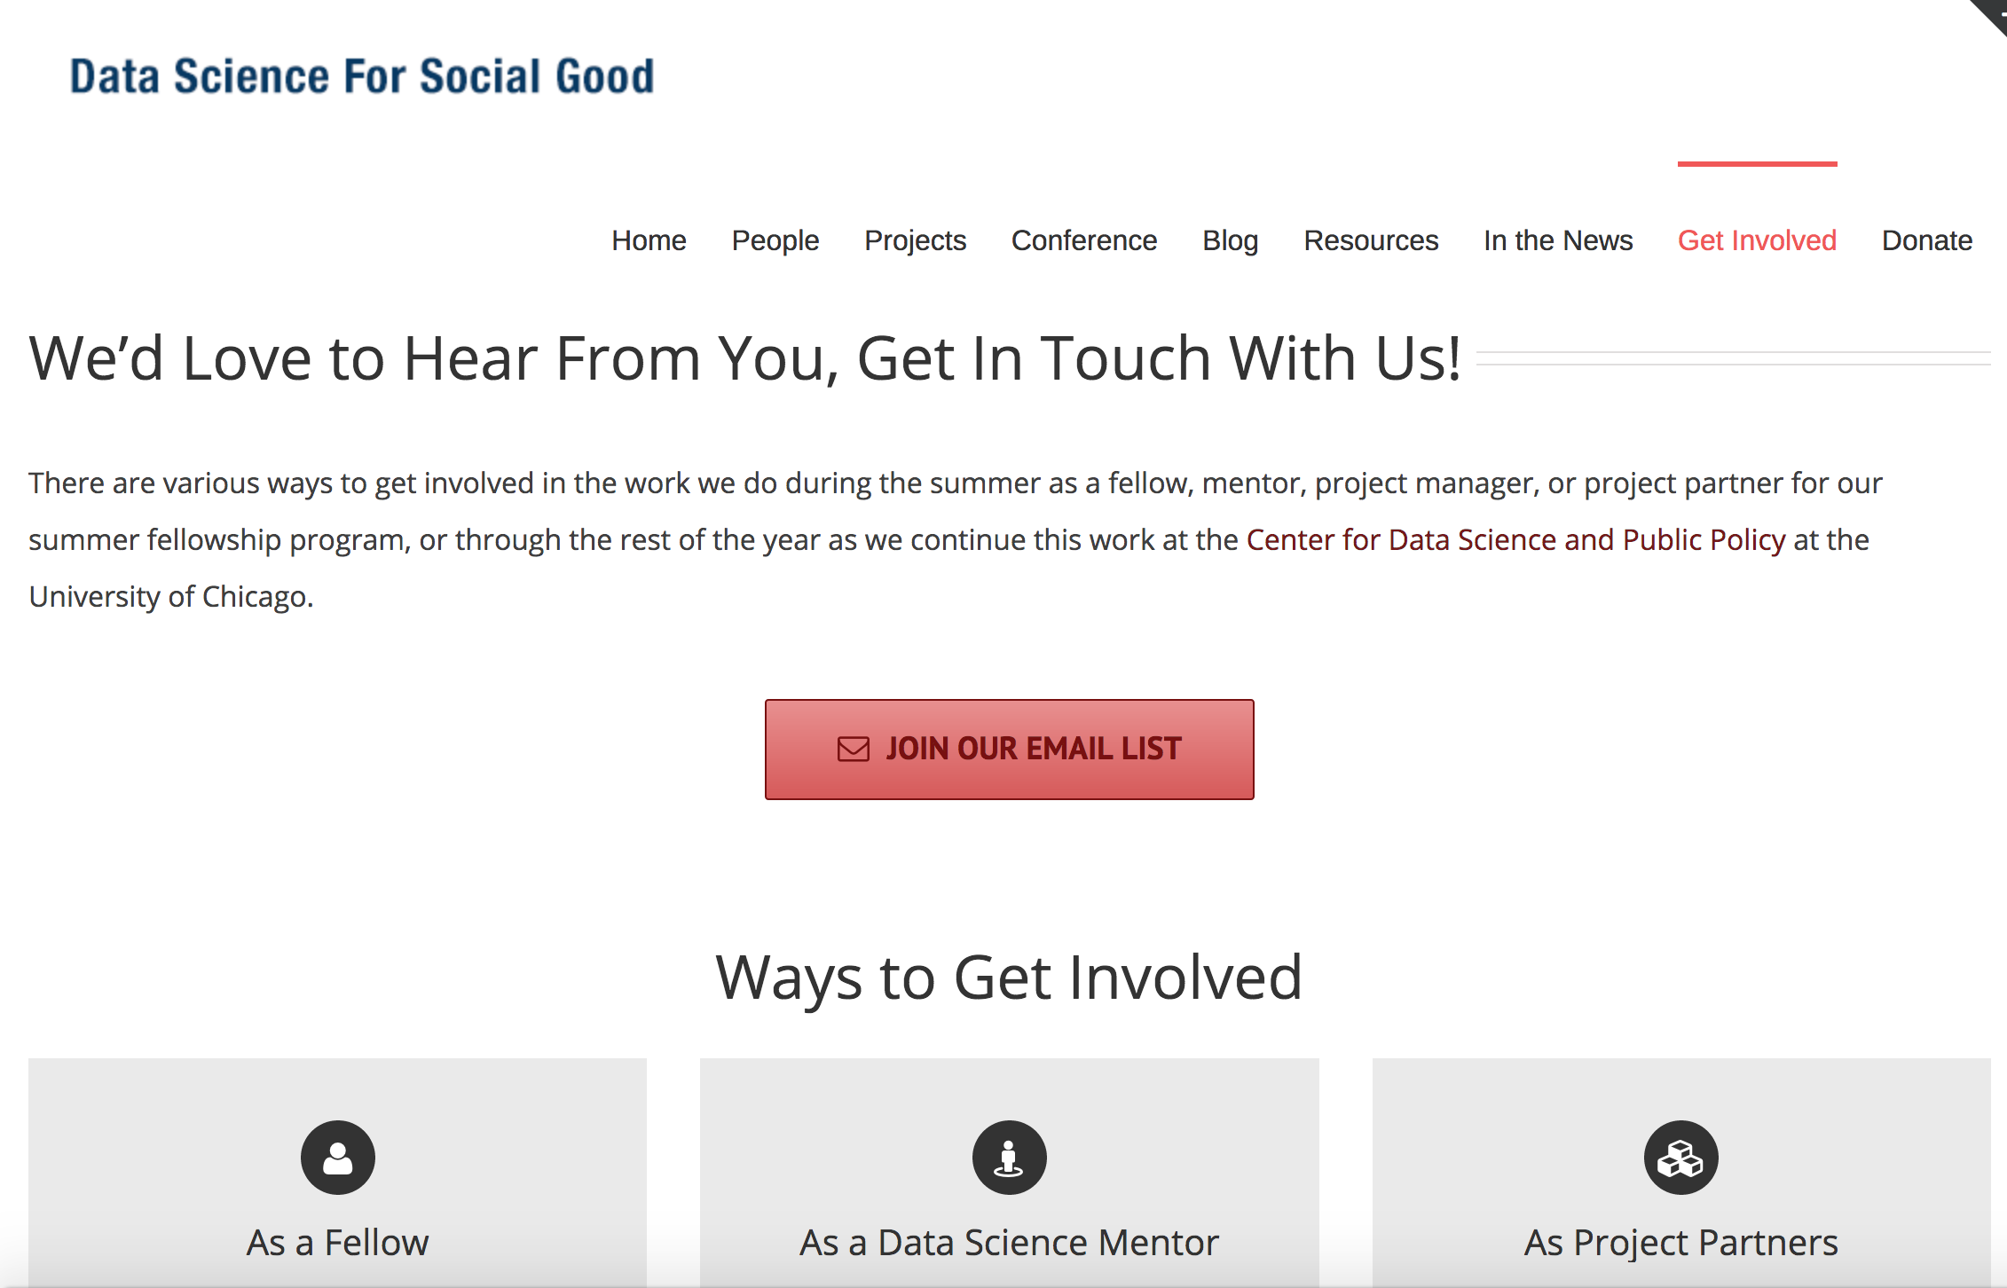
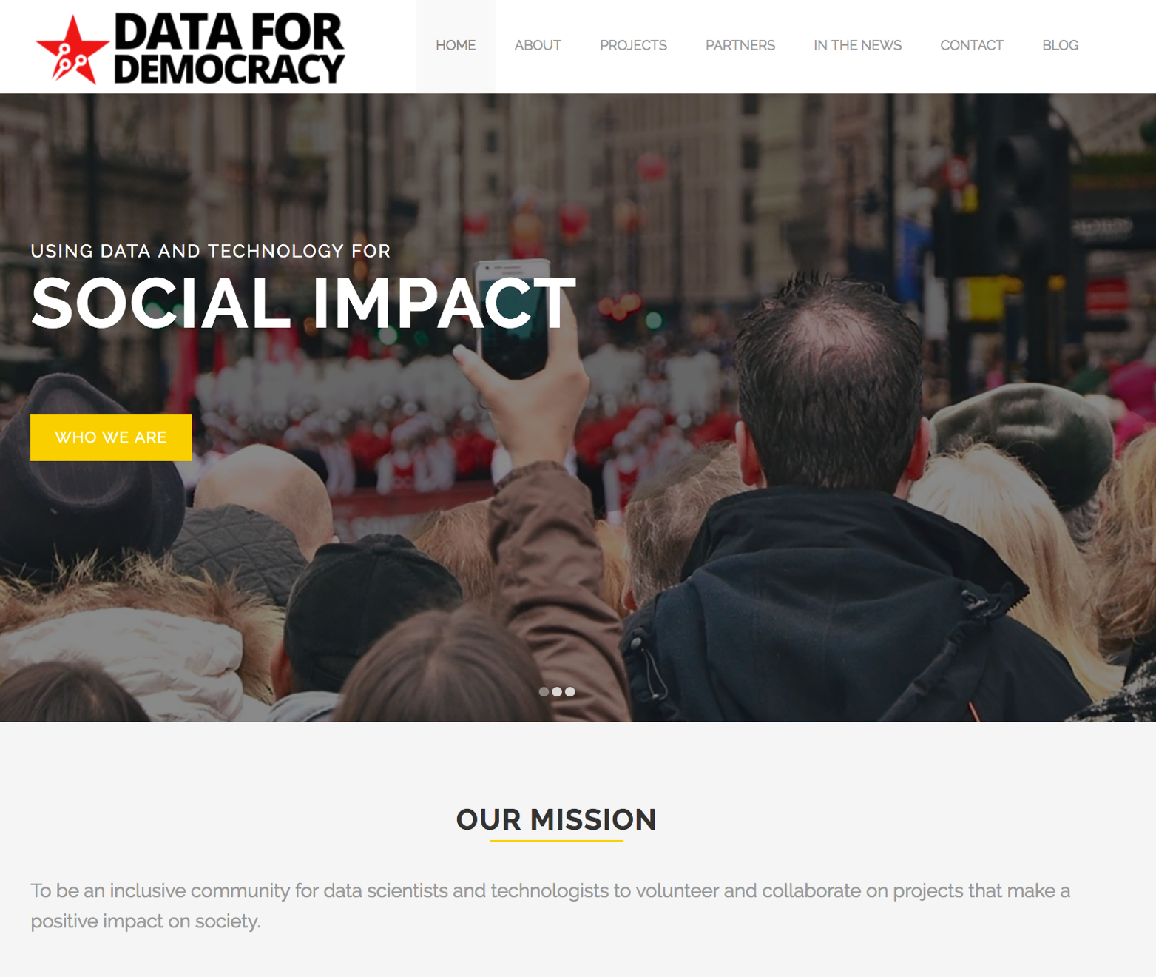
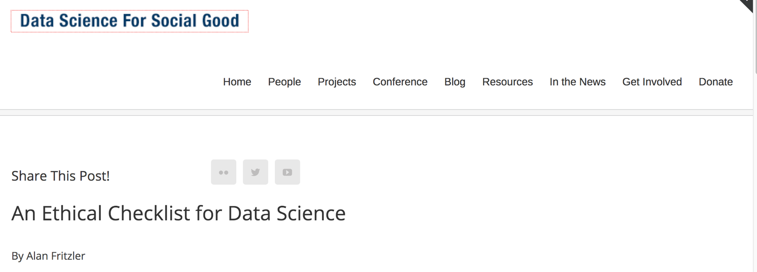
Codes of Ethics
http://datafordemocracy.org/
https://dssg.uchicago.edu/contact-page/
https://dssg.uchicago.edu/2015/09/18/an-ethical-checklist-for-data-science/

Slide 49
Algorithmic Literacy
“Algorithms all have their own ideologies. As computational methods and data science become more and more a part of every aspect of our lives, it is essential that work begin to ensure there is a broader literacy about these techniques and that there is an expansive and deep engagement in the ethical issues surrounding them.”
Trevor Owens
Library of Congress / Former IMLS
http://www.pewinternet.org/2017/02/08/theme-7-the-need-grows-for-algorithmic-literacy-transparency-and-oversight/

Slide 50
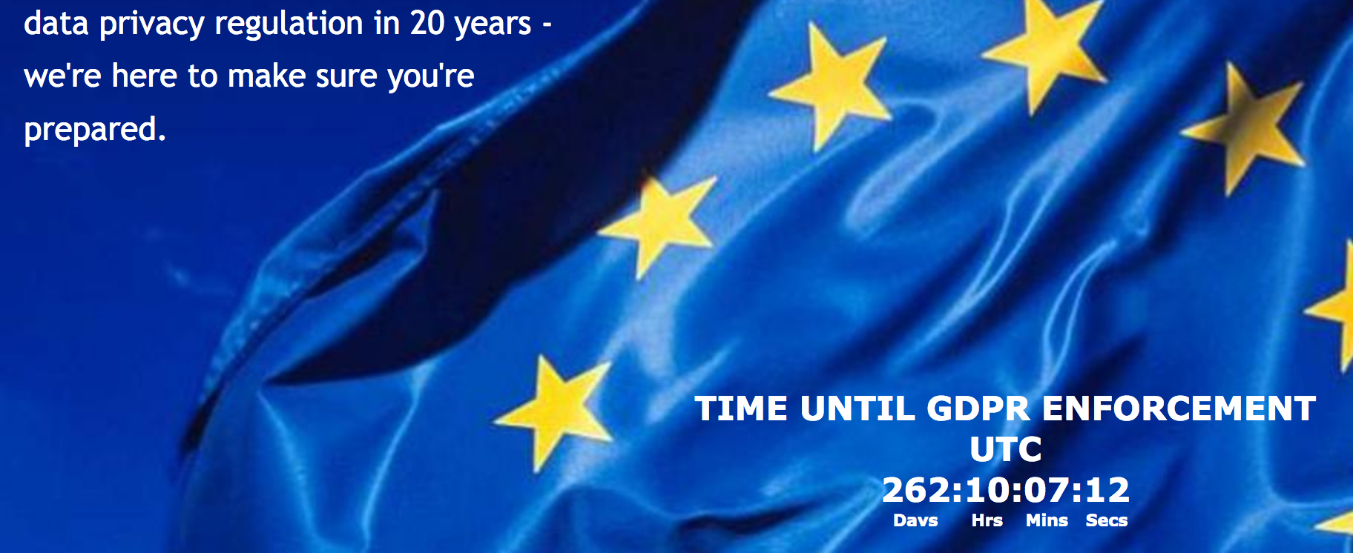
EU General Data Protection Regulation
Requires securing personal data
Provides an opt out on any data collection
Puts limitations around profiling

Slide 51
The Right to an Explanation
“The data subject shall have the right to obtain … the existence of automated decision-making, including profiling … meaningful information about the logic involved, as well as the significance and the envisaged consequences of such processing for the data subject.”
GDPR Chapter 3, Article 15

Slide 52
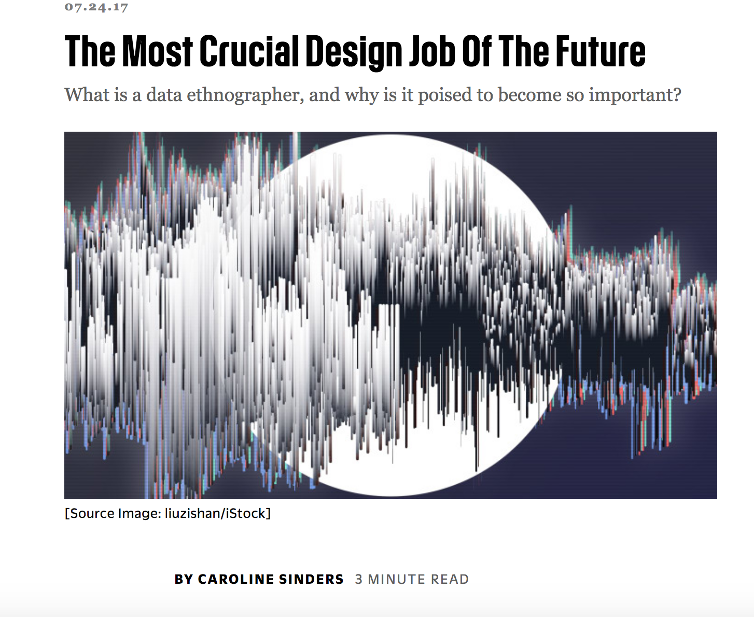
Data Ethnography
https://www.fastcodesign.com/90134155/the-most-crucial-design-job-of-the-future

Slide 53
Data Ethnography
“I advocate we need data ethnography, a term I define as the study of the data that feeds technology, looking at it from a cultural perspective as well as a data science perspective.”

Slide 54
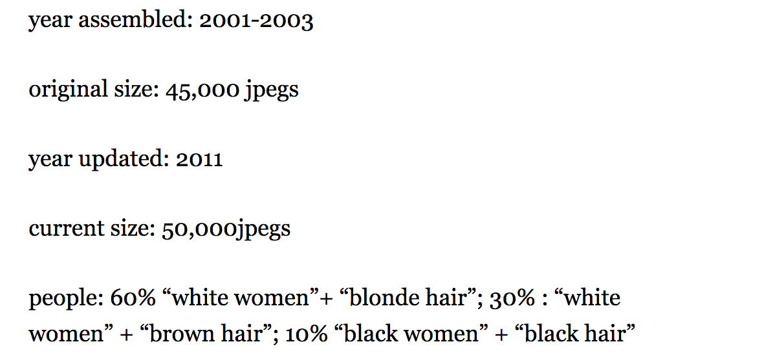
Is this not metadata?
“social media data, Twitter, 2021, U.S., 75% male users ages 35-40, 50% white.”
Quote and Image from: https://www.fastcodesign.com/90134155/the-most-crucial-design-job-of-the-future

Slide 55
Librarians as Data Ethnographers
Librarians have experience:
Evaluating Information Quality
Documenting and cataloging resources
Documenting provenance
Libraries are invested in:
Social Justice
Critical Theory

Slide 56
Many roles for libraries
Curate and assess datasets
Identify bias in datasets
Help ML students understand these biases
Teach algorithmic literacy
Become (and training) Data Ethnographers
Contribute to standardization around data management and interoperability
But we must first develop machine learning expertise!

Slide 57



Hints of investment
https://future-of-libraries.mit.edu/
http://msdse.org/
https://youtu.be/L0G9JsPMEXY

Slide 58
Summary
AI has advanced significantly
This has great potential for social good
There is a downside and a risk of algorithmic injustice
Libraries can help to mitigating this injustice
That starts by making AI and ML areas of investment

Slide 59
Corey A Harper
@chrpr
c.harper@elsevier.com

